Slide 1
MCAS STE Pilot Test Administration Training
The Office of Student Assessment Services
January 19, 2024
Last updated February 22, 2024

Slide 2
Presenters
Corrine Steever (DESE), Innovative Assessment Project Manager
Gloria Hernandez (Pearson), Customer Technical Service Representative

Slide 3
Logistics for This Session
Questions may be asked at any time using the Q&A feature on the Zoom Webinar screen.
We will pause to answer questions in the Q&A throughout the training.
Questions about a specific student should be sent by email to:
MCAS: mcas@doe.mass.edu
STE Pilot: iada_DESE@mass.gov
This training is being recorded and will be available online in approximately one week on the Massachusetts STE Pilot Resource Center.

Slide 4
Today’s Agenda
01
STE Pilot Overview
02
Important Dates/Timelines
03
PearsonAccess^{next} Registration Information
04
PearsonAccess^{next} Demonstration
05
Resources & Support

Slide 5
STE Pilot Overview
01

Slide 6
Transition to the new grades 5 and 8 STE
2021-2024
2024-2025
2025-2026
Incorporate lessons learned
Less text, more purpose
Improved accessibility
Piloting
Pilot tested with over 25,000 students with demographics similar to the state overall in 2021 and 2022
24,000 students piloting in 2024
Refine tasks from pilot years
Scores not used in state accountability
SPA Ambassador Training
Prepare for statewide use
Anticipated statewide field test for all grade 5 and 8 students
Provide guidance and classroom tasks that educators can use
Anticipated first operational year with results reported to schools and districts
https://www.doe.mass.edu/mcas/tdd/ste-assess-pilot/default.html

Slide 7
Practice Tests & Sample Tasks
Recommend both an MCAS Science practice test and an MCAS STE Pilot sample task.
One MCAS regular Science practice test
Available on the MCAS Resource Center and in the TestNav app
Infrastructure trial forms to be available in the MCAS PAN Training site: https://trng-mcas.pearsonaccessnext.com/
One MCAS STE Pilot sample task
Available on the Massachusetts STE Pilot Resource Center and in the TestNav app
Infrastructure trial forms to be available in the MCAS PAN Training site: https://trng-mcas.pearsonaccessnext.com/

Slide 8
Overview – MCAS STE Pilot Testing
Students participating in the MCAS STE Pilot will take two test sessions during this Spring’s testing.
Testing window: April 23 – May 24
Students should be registered in the Spring 2024 STE Pilot administration in PearsonAccess^{next} (PAN).
This admin contains:
STE Pilot – Sess. 1 - Subset of questions from MCAS
STE Pilot – Sess. 2 - New innovative performance tasks
STE VOCAL Questionnaire

Slide 9
Overview – MCAS STE Pilot Registration
Test Names:
Grade X STE Pilot – Sess. 1
Grade X STE Pilot – Sess. 2
Grade X STE Pilot - Questionnaire
PAN Admin:
Spring 2024 STE Pilot
MCAS STE Pilot
All grade 5 & 8 students at schools participating in the pilot
New for Spring 2024: Both test sessions and the questionnaire are combined into one admin

Slide 10
Overview – MCAS STE Pilot Accommodations
All accommodations are supported for Session 1 and Session 2
Alternative Cursor Mouse Pointer | Human Scribe as a Standard Accommodation
Answer Masking | Human Signer as a Standard Accommodation
Assistive Technology | Large Print Test Edition
Braille Test Edition | Screen Reader Edition
Calculation Device | Speech-to-Text as a Standard Accommodation
Color Contrast | Text-to-Speech
Graphic Organizer/Reference Sheet | Typed Responses
Human Read Aloud as a Standard Accommodation | Web Extensions

Slide 11
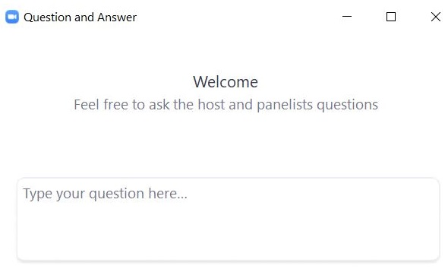
Questions and Answers
Use the “Q&A” feature to ask questions.

Slide 12
Important Dates/Timelines
02

Slide 13
Important Dates: MCAS STE Pilot (Sessions 1 & 2)
Task | Dates
Pre-Administration SR/PNP (Paper) | 1/22/24 – 2/2/24
Pre-Administration SR/PNP (CBT) | 1/22/24 – 4/22/24
Create PAN Sessions | 4/9/24 -5/24/24
Precaching Content | 4/16/24 - 5/24/24
Prepare PAN Sessions | 4/19/24 - 5/24/24
Start PAN Sessions | 4/22/24 - 5/24/24
MCAS STE Pilot (Sessions 1 & 2) Administration | 4/23/24 - 5/24/24

Slide 14
Tasks & Timelines in PearsonAccess^{next} (PAN)
Task | Timeline | Who is Responsible
Create PAN Sessions | Two weeks before testing (recommended) | District Test Coordinator OR School Test Coordinator/Principal OR Technology Coordinator
Prepare PAN Sessions | Up to two days before testing | All PAN Users have access to these functions. Schools and districts should determine who is responsible for each task. DESE suggests that principals prepare PAN Sessions, print testing tickets, and start PAN Sessions and that test administrators unlock PAN Sessions.
Print testing tickets | Up to two days before testing
Start PAN Sessions | Up to one day before testing
Unlock PAN Sessions | Day of testing

Slide 15
PearsonAccess^{next} Registration
03

Slide 16
The .CSV File for STE Pilot Test Administration
DESE will post .CSV files to DropBox Central on the first day of the SR/PNP window of each administration.
Locate the .CSV file “Spring2024_...pilot_STE_SRPNP” and save it to your computer.
The .CSV files for the SR/PNP will be current as of approximately two weeks before the opening of each window.
Selected accommodations are prepopulated as follows.
Subject | Spring 2023 Grades | Source of Accommodations Data
ELA and Math | Grades 4–8 | Grades 3–7 Spring 2023 in those subjects
ELA and Math | Grade 10 | Grade 8 Spring 2022 in those subjects
STE for grades 5 and 8 | Grades 5 and 8 | Grades 4 and 7 Math Spring 2023
STE for high school | Grade 9 only | Grade 8 STE Spring 2023

Slide 17
PearsonAccess^{next} (PAN) Tasks
The actions needed in PAN to prepare for, and administer, the MCAS STE Pilot is the same as all other administrations.
For information on general PAN steps, or other PAN information, please access previous training and reference existing manuals. http://mcas.pearsonsupport.com.
Upcoming training sessions can be found here: www.doe.mass.edu/mcas/training.html

Slide 18
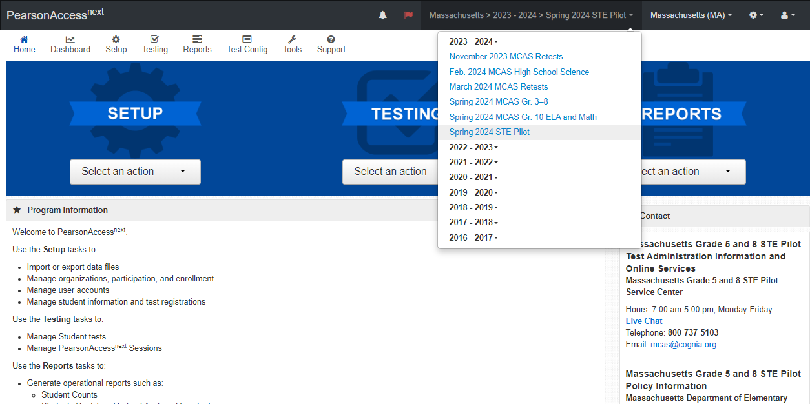
PearsonAccess^{next} (PAN) Registration
Schools participating in the pilot need to register their Grade 5 & 8 students in the Spring 2024 STE Pilot admin for their STE testing
MCAS STE Pilot
Sessions 1 & 2 (along with the questionnaire) are in PAN Admin:
Spring 2024 STE Pilot
Notes:
.

Slide 19
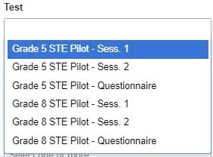
PearsonAccess^{next} (PAN) Registration
Schools not participating in the pilot will not be able to register students in the Spring 2024 STE Pilot admin.
Important to note: Separate PAN sessions will need to be created for Session 1, Session 2, and the Questionnaire

Slide 20
PearsonAccess^{next} (PAN) Registration
The MCAS STE Pilot, Session 1 should be taken first.
The MCAS STE Pilot, Session 2 should be taken on a different day from the MCAS STE Pilot, Session 1.
A separate Principal’s Certification of Proper Test Administration (PCPA) is not needed for the MCAS STE Pilot.
Only one PCPA needs to be completed after all ELA, math, and science testing has concluded for grades 3-8.
The STE Pilot manuals will be printed/shipped and available on the Massachusetts STE Pilot Resource Center.

Slide 21
Poll Question 1
What PAN admin do I use to register my grade 5 and/or 8 students for the STE Pilot?
Spring 2024 STE Pilot
Spring 2024 MCAS Gr. 3-8
Both Spring 2024 MCAS Gr. 3-8 and Spring 2024 STE Pilot
I don't know

Slide 22
Questions and Answers
Use the “Q&A” feature to ask questions.

Slide 23
PearsonAccess^{next} Demonstration
04
Registering for the STE Pilot

Slide 24
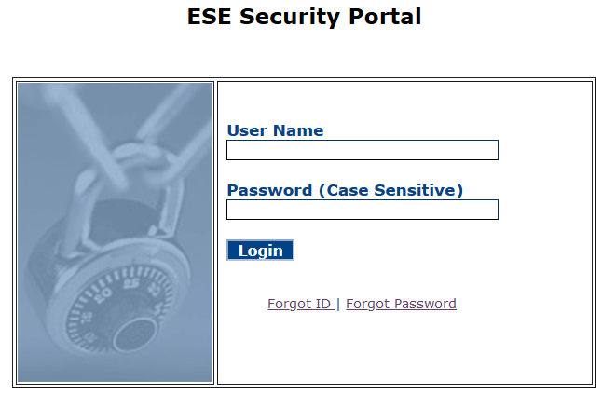
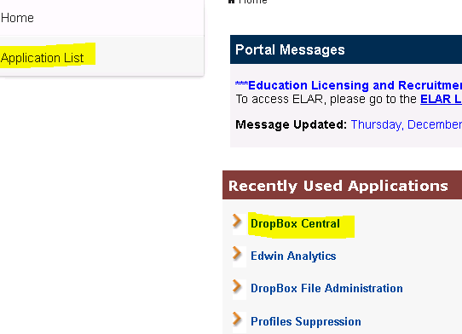
Registering for the STE Pilot Step 1: Locate and Download .CSV for the Pilot
Log into the DESE Security Portal https://gateway.edu.state.ma.us/ .
Enter your username and password.
Select DropBox Central.
Select MCAS 2024 Data.
Click Next.
Locate the .CSV file “Spring2024_...pilot_STE_SRPNP” and save it to your computer.

Slide 25
Registering for the STE Pilot Step 2: Prep .CSV for Import
Open the downloaded .CSV file.
Update as needed.
Reference the MCAS SR/PNP Guide
Add/remove student who transfers in/out
Update accommodations
Student SR/PNP details imported to the Spring 2024 STE Pilot admin should mirror those imported into the Spring 2024 MCAS Gr. 3-8 admin. Exception is Column L (first-year ELs). These students must participate in STE testing.
Notes:
Reminder from previous slide that the .CSV files for the SR/PNP will be current as of approximately two weeks before the opening of each window.
Reminder from previous slide that accommodations are prepopulated from Grades 4 and 7 Math Spring 2023.

Slide 26
Registering for the STE Pilot Step 2: Prep .CSV for Import
Important: Test Code, Column J, will be blank and should remain blank.
This admin is set up to automatically register students for all three test codes (Session 1, Session 2 and the Questionnaire) based on grade.
Save the updated .CSV file.

Slide 27
Registering for the STE Pilot Step 3: Import the file
Return to PAN and select the Spring 2024 STE Pilot test administration on the top right.
Note: PAN will default to the last administration in which you were working, and you may need to switch to this admin in the dropdown menu.
Under Setup, select “Import / Export Data.”
Click the Select Tasks dropdown, and check “Import / Export Data.”
Click “Start.”

Slide 28
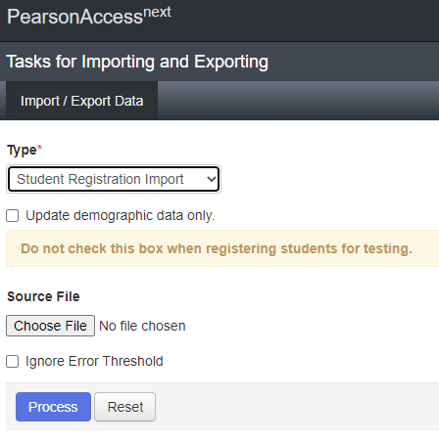
Registering for the STE Pilot Step 3: Import the file
In the Type dropdown, select “Student Registration Import.”
Leave the option “Update Demographic Data Only” unchecked.
Choose the .CSV file you saved previously and select “Process.”
Leave the option “Ignore Error Threshold” unchecked.

Slide 29
Registering for the STE Pilot Step 3: Import the file
You can click the blue refresh button at the top to see current status. When the file has completed processing, a green banner with the message “Complete” will appear on the screen.
Confirm that all records have been successfully imported (message on screen).

Slide 30
Poll Question 2
One of your students needs an update to their SR/PNP after initial upload. What should be your next step?
Update in the Spring 2024 MCAS Gr. 3-8 admin ONLY
Update in the Spring 2024 STE Pilot admin ONLY
Update in BOTH admins
I don't know

Slide 31
Questions and Answers
Use the “Q&A” feature to ask questions.

Slide 32
Sandbox time
Which of the following demos would you like to see us do again?
Prepping the file for import
Importing the file
I do not need to see any of the demos again

Slide 33
Resources & Support
05

Slide 34
Reference: Spring 2024 STE Pilot Test Codes
The test codes for students participating in the STE Pilot differ from the regular MCAS STE test codes. This shows which codes correlate to which test sessions and is helpful to reference when creating student sessions via the SR/PNP import.
STE Pilot – Sess. 1
Test Codes:
SCI05MS1
SCI08MS1
STE Pilot – Sess. 2
Test Codes:
SCI05PIS1
SCI08PIS1
STE Pilot - Questionnaire
Test Codes:
SCI05MS3
SCI08MS3

Slide 35
Reference: Creating Sessions
If sessions are going to be created by .CSV import, the session names need to be assigned to each of the three test codes.
This can be done within the .CSV file in two ways:
By adjusting the Student Registration Import .CSV file so there are three rows for each student, with each test code on its own row (in Column J), along with the preferred session name (in Column M) for each test code. This can be done during the initial registration import or as a second import.
Note: Uploading a session name to one student record without the test code populated in column J, such as on initial import, will not result in unique session names being auto-created for each test code. Session names need to be listed out by test code if creating sessions via import.
By performing a Student Registration Export after initial import which will automatically show three records for each student, with test codes populated. Enter the preferred session name (in Column M) for each test code, then perform a Student Registration Import to create the sessions.

Slide 36
Resources & Support – STE Pilot
The Massachusetts STE Pilot Resource Center
https://ma-innov-sci.mypearsonsupport.com/ includes the following:
A recording of this session
Sample Tasks
Test Administrator Manuals
Principal’s Administration Manual
Statewide Testing Schedule and Administration Deadlines
Other materials from MCAS

Slide 37
Resources & Support – MCAS and MCAS STE Pilot
General test administration questions on logistics and technology (e.g., PearsonAccess^{next}, SR/PNP, TestNav) should be directed to the MCAS service center.
Web: mcas.pearsonsupport.com/
Email: mcas@cognia.org
Phone: 800-737-5103
Schedule a Technology Support Call

Slide 38
Other Available MCAS Resources
Resource | Location Online
Guide to the SR/PNP Process (includes common error codes) | mcas.pearsonsupport.com/manuals/ (Click on “PearsonAccess Next Guidance”)
User Role Matrix | mcas.pearsonsupport.com/pearsonaccessnext/ (Click on “User Information”)
Guide to Managing User Accounts in PearsonAccess Next
File layouts: SR/PNP Template (file layout) PAN User Export file layout | mcas.pearsonaccessnext.com/ Support > Documentation
Training resources Online training modules on the SR/PNP and accessibility and accommodations | mcas.pearsonsupport.com/training
Upcoming training opportunities | www.doe.mass.edu/mcas/training.html
Accessibility and Accommodations Manual | www.doe.mass.edu/mcas/accessibility/
Crosswalk of Accessibility Features and Accommodations & SR/PNP Columns – Appendix E of the Accessibility and Accommodations Manual | https://www.doe.mass.edu/mcas/accessibility/manual-appx-e.docx

Slide 39
THANK YOU
DESE Innovative Assessment
MCAS STE Pilot Policy Questions
781-338-3141
iada_DESE@mass.gov
MCAS Policy Questions
781-338-3625
mcas@doe.mass.edu
www.doe.mass.edu/mcas
135 Santilli Highway, Everett, MA 02149

